Slide 1
Chapter 13

Slide 2
Objectives

Slide 3
Objectives (continued)

Slide 4
Common types of events

Slide 5
HTML events

Slide 6
Mouse events

Slide 7
Keyboard events

Slide 8
The DOM addEventListener and removeEventListener methods

Slide 9
Cross-browser compatible functions

Slide 10
How to add multiple event handlers to a single button

Slide 11
Common HTML elements that have default actions for the click event

Slide 12
DOM-compliant code that cancels the default action

Slide 13
Cross-browser compatible code that cancels the default action

Slide 14
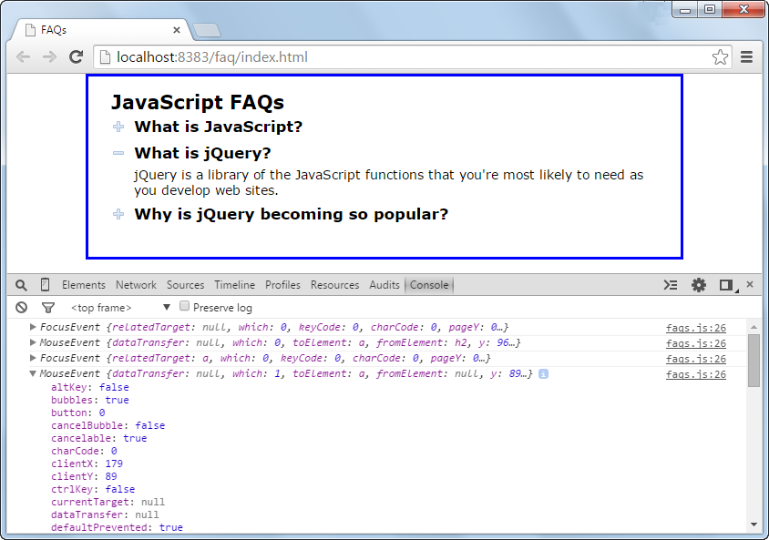
The FAQs app with the Console panel open

Slide 15
The library_event.js file

Slide 16
The faqs.js file

Slide 17
The faqs.js file (continued)

Slide 18
Two mouse events

Slide 19
Event handlers for the two mouse events

Slide 20
How to create an image rollover

Slide 21
How to preload an image with the Image object

Slide 22
How to preload the second image in the rollover example

Slide 23
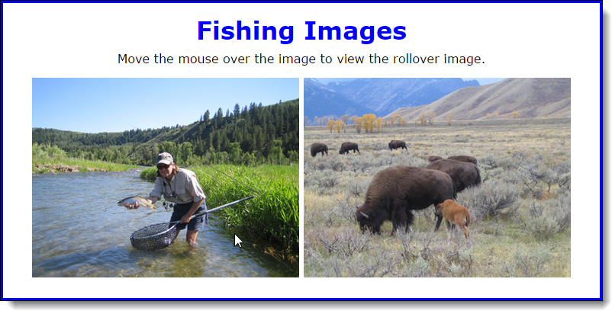
A Rollover application while the mouse is over the image on the left

Slide 24
The head element of the HTML file

Slide 25
The rollover.js file

Slide 26
The rollover.js file (continued)

Slide 27
Two methods for working with a timer that calls a function once

Slide 28
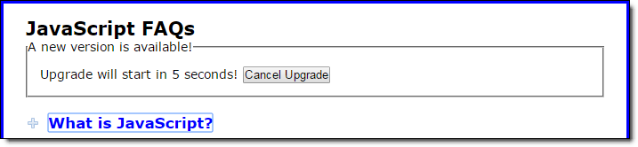
The FAQs application with an upgrade that starts after 5 seconds

Slide 29
How to use the setTimeout method to start or cancel the upgrade

Slide 30
Two methods for working with a timer that calls a function repeatedly

Slide 31
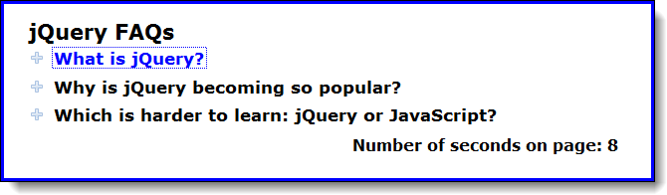
The FAQs application with a counter at the bottom

Slide 32
How to use the setInterval method to add a counter to a page

Slide 33
How to use an anonymous function with the setInterval method

Slide 34
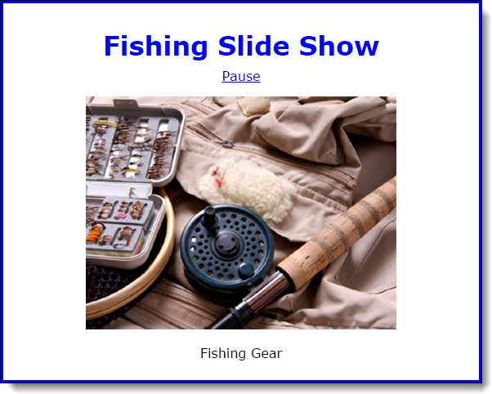
The Slide Show application in the browser

Slide 35
The HTML for the application

Slide 36
The library_slide_show.js file

Slide 37
The library_slide_show.js file (continued)

Slide 38
The library_slide_show.js file (continued)

Slide 39
The library_slide_show.js file (continued)

Slide 40
The slide_show.js file

Slide 41
What the onload event handler does

Slide 42
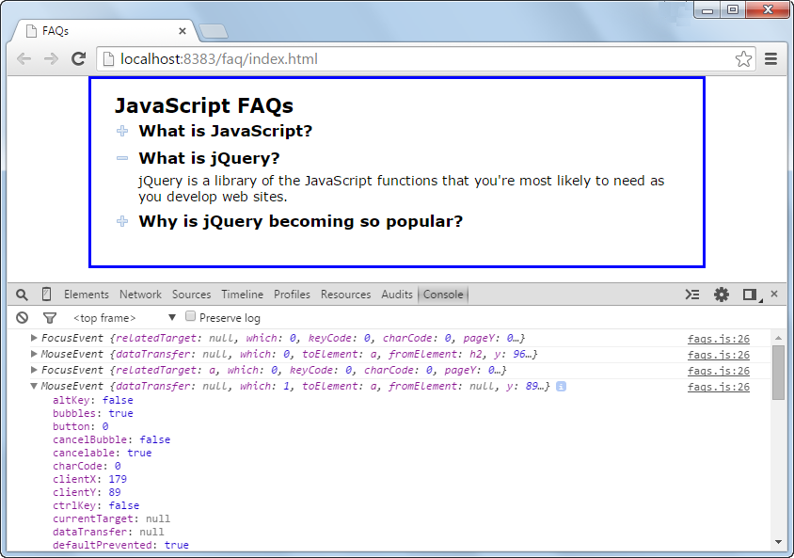
Exercise 13-1 Test the FAQs application

Slide 43
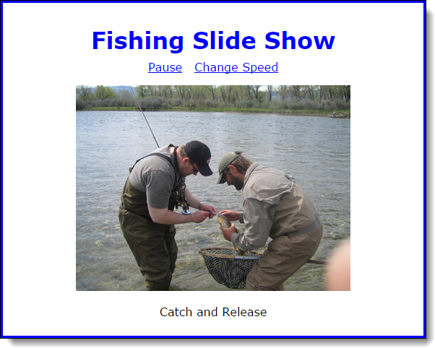
Exercise 13-2 Enhance the Slide Show application

Slide 44
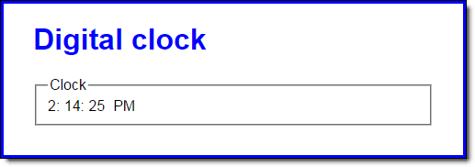
Extra 13-1 Develop the Clock application

Slide 45
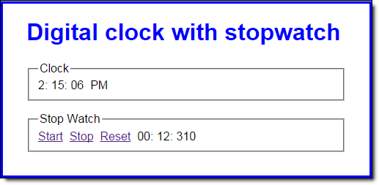
Extra 13-2 Add a stopwatch to the Clock app

Slide 46
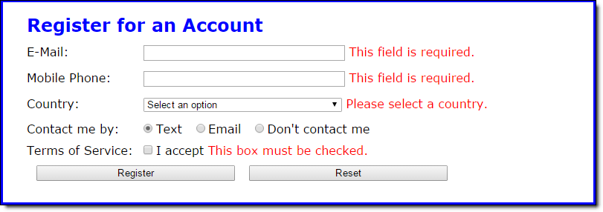
Short 13-1 Prevent form submission until valid

